Slide 1
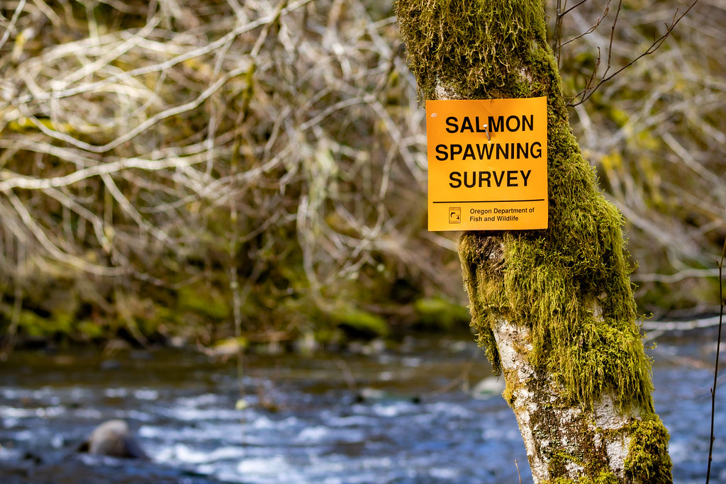
Understanding precision and directional bias of fisheries abundance estimates across 24 commonly used salmonid survey methods

Slide 2
Understanding precision and directional bias of fisheries abundance estimates across 24 commonly used salmonid survey methods

Slide 3
Background

Slide 4
Why salmon are important?

Slide 5
Why salmon are important?
Ecologically crucial species

Slide 6
Why salmon are important?
Ecologically crucial species
Marine nutrients found in trees in central Idaho

Slide 7
Why salmon are important?
Ecologically crucial species
Marine nutrients found in trees in central Idaho
Cultural significance

Slide 8
Why salmon are important?
Ecologically crucial species
Marine nutrients found in trees in central Idaho
Cultural significance
Central to Indigenous ways of life and cultural identity

Slide 9
Why salmon are important?
Ecologically crucial species
Marine nutrients found in trees in central Idaho
Cultural significance
Central to Indigenous ways of life and cultural identity
Commercial significance

Slide 10
Why salmon are important?
Ecologically crucial species
Marine nutrients found in trees in central Idaho
Cultural significance
Central to Indigenous ways of life and cultural identity
Commercial significance
$7.2 million in OR in 2024

Slide 11
How are salmon doing?

Slide 12
How are salmon doing?
Not great in the lower 48

Slide 13
How are salmon doing?
Not great in the lower 48
28 population groups of salmon/trout listed as endangered or threatened under ESA

Slide 14
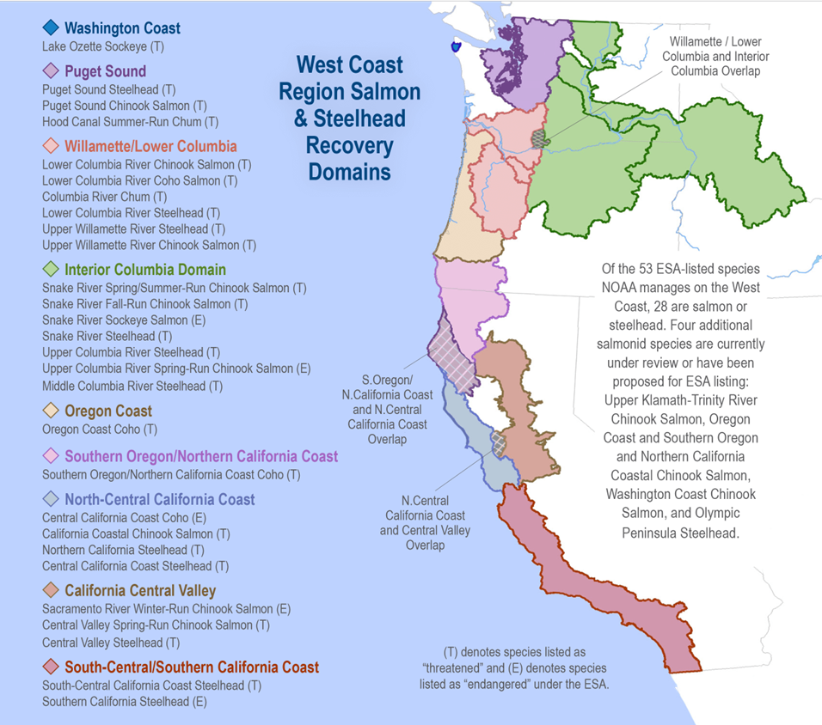

Slide 15
How are salmon doing?
Not great in the lower 48
28 population groups of salmon/trout listed as endangered or threatened under ESA
13 of these in Columbia Basin

Slide 16
How are salmon doing?
Not great in the lower 48
28 population groups of salmon/trout listed as endangered or threatened under ESA
13 of these in Columbia Basin
Despite restoration efforts

Slide 17
How are salmon doing?
Not great in the lower 48
28 population groups of salmon/trout listed as endangered or threatened under ESA
13 of these in Columbia Basin
Despite restoration efforts
$ 9 billion spent in Columbia Basin since 1990s

Slide 18
How do we know how salmon are doing?

Slide 19
How do we know how salmon are doing?
We count them!

Slide 20
How do we know how salmon are doing?
We count them!
Well, we count some of them

Slide 21
How do we know how salmon are doing?
We count them!
Well, we count some of them and make educated guesses about the rest…

Slide 22
How do we know how salmon are doing?
We count them!
Well, we count some of them and make educated guesses about the rest…
Using a variety of survey methods and monitoring techniques

Slide 23
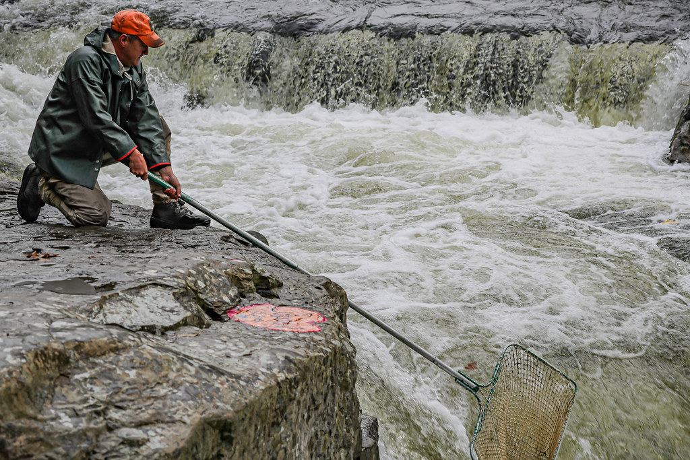
How do we know how salmon are doing?

Slide 24
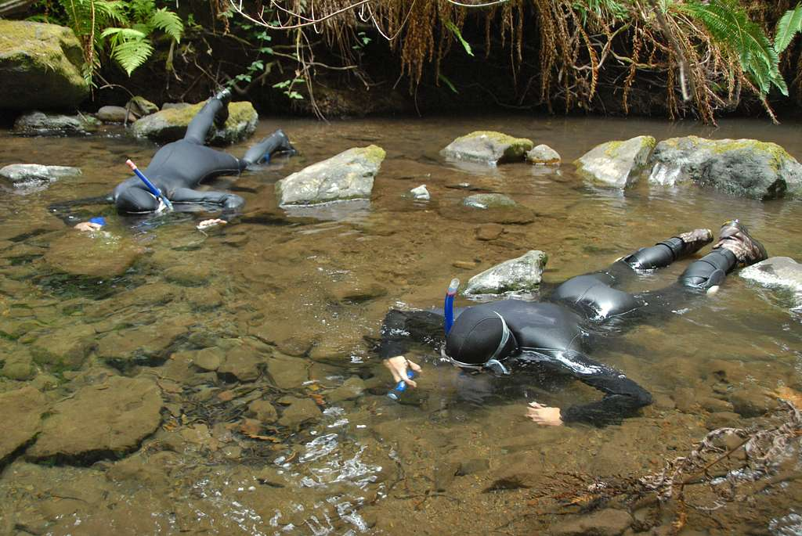
How do we know how salmon are doing?

Slide 25
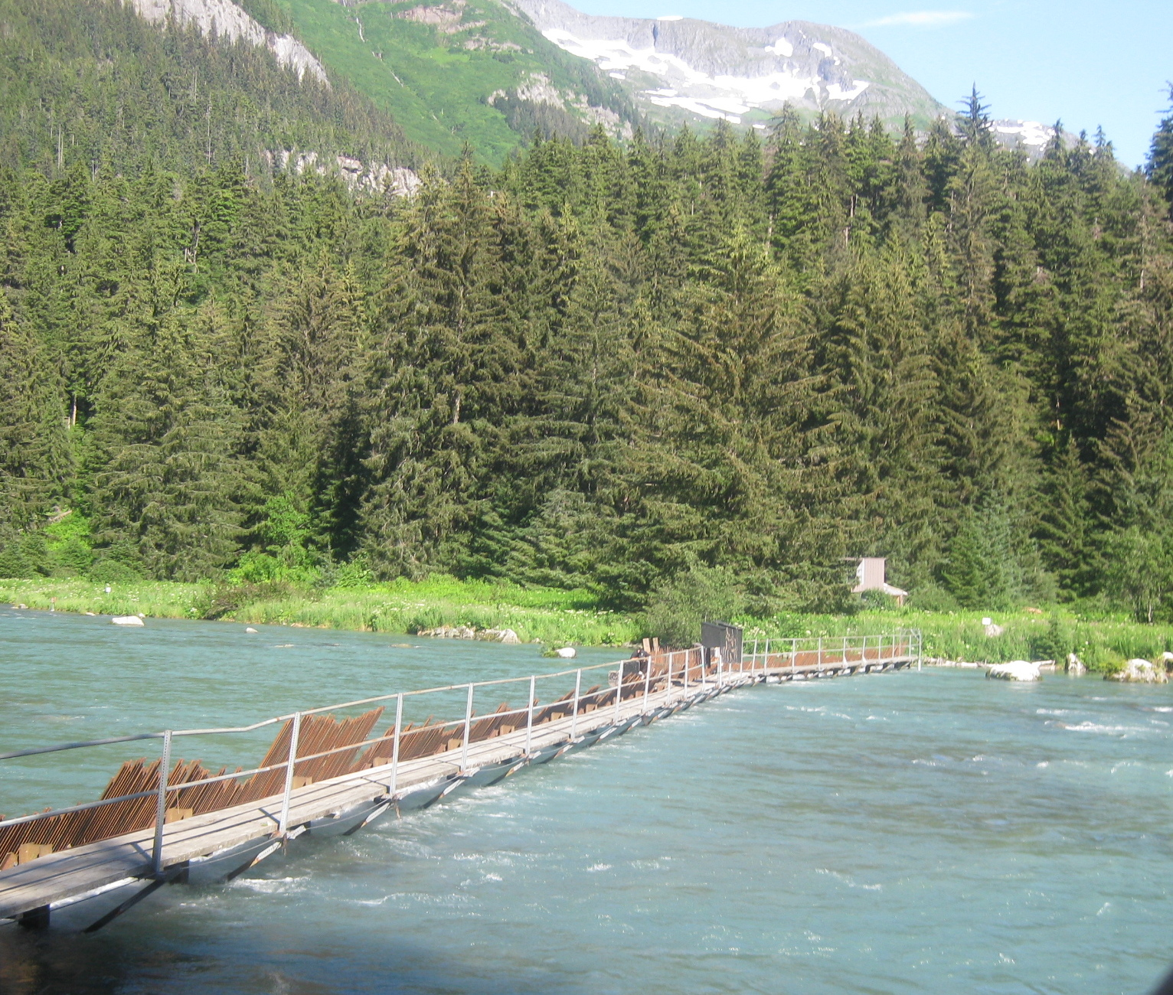
How do we know how salmon are doing?

Slide 26
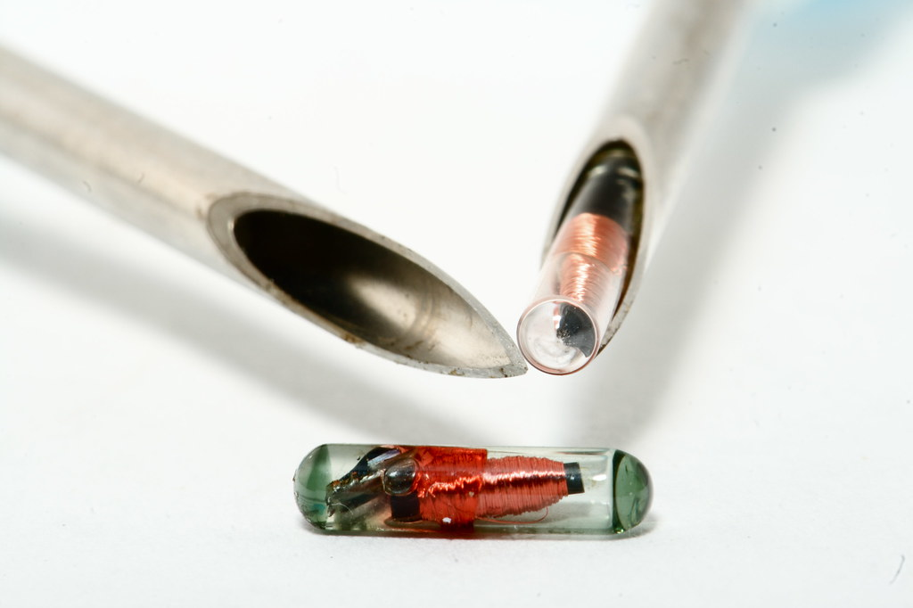
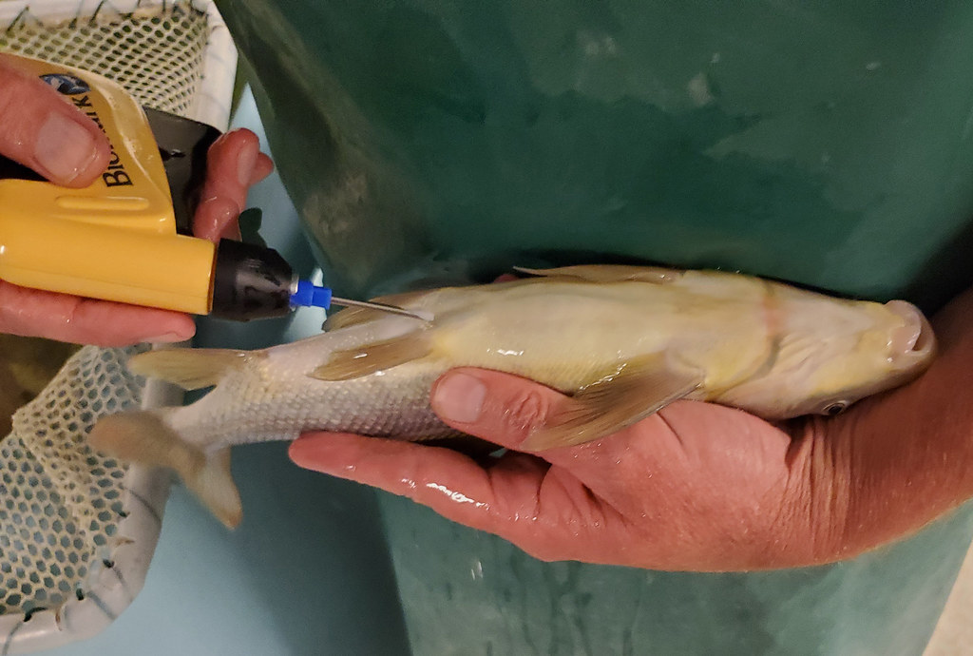
How do we know how salmon are doing?

Slide 27
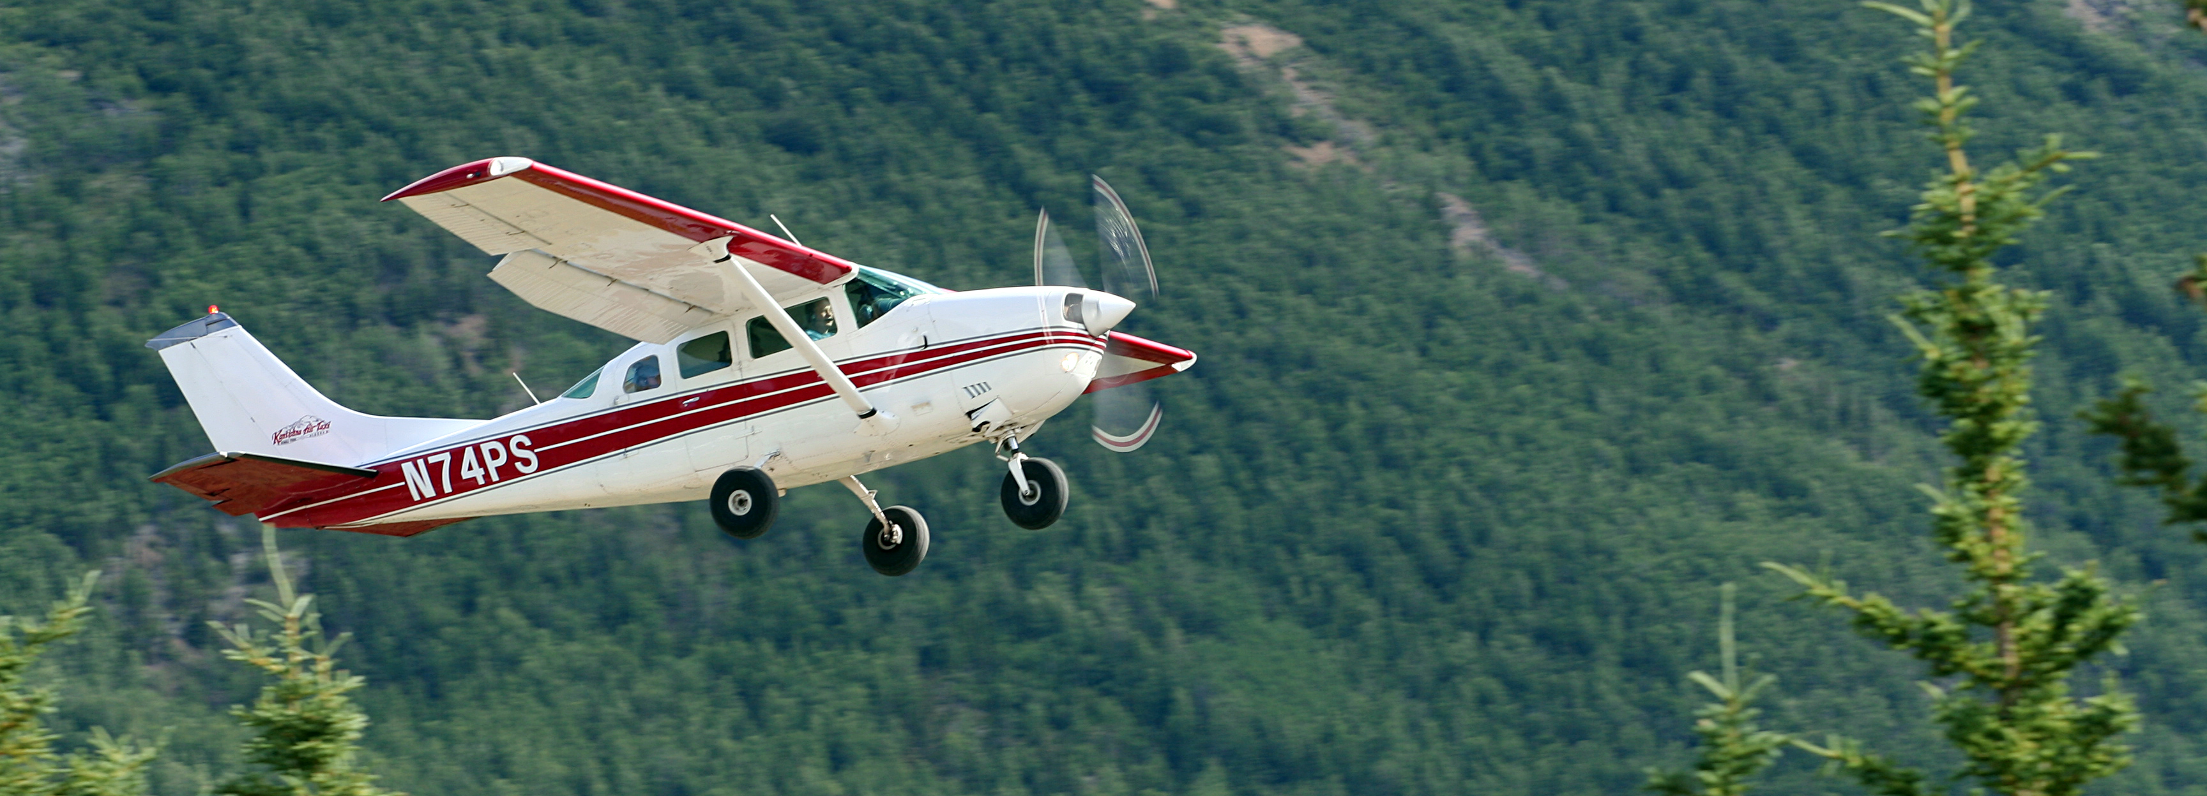
How do we know how salmon are doing?

Slide 28
How do we know how salmon are doing?

Slide 29
Research goal: Evaluate salmon survey methods for precision and directional bias

Slide 30
Data

Slide 31
Data
Spawning salmon estimates in Oregon
68 salmonid populations
3 species: Chinook, coho, steelhead
Annual observations, 1980 to 2022
31 survey methods

Slide 32
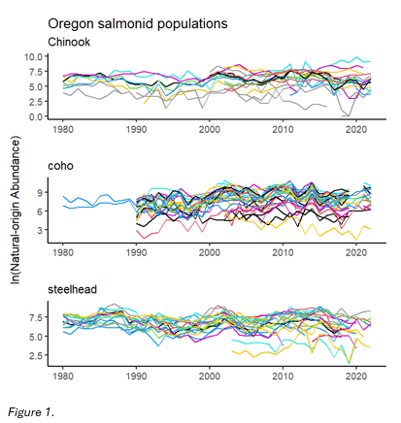
Data – abundance estimates

Slide 33
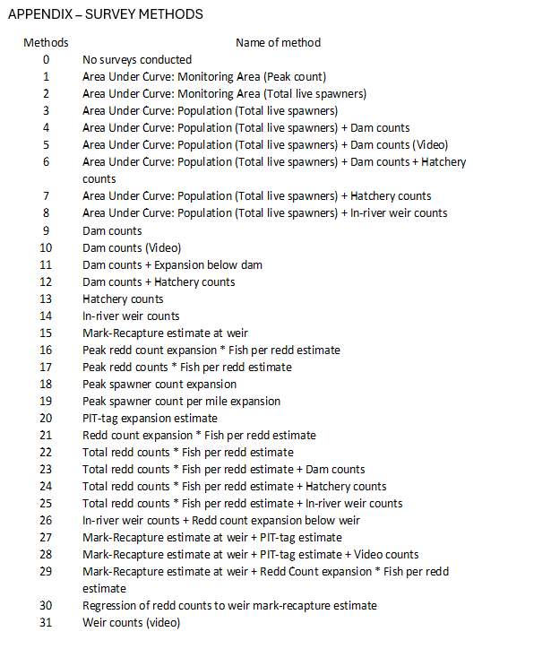
Data – survey methods

Slide 34
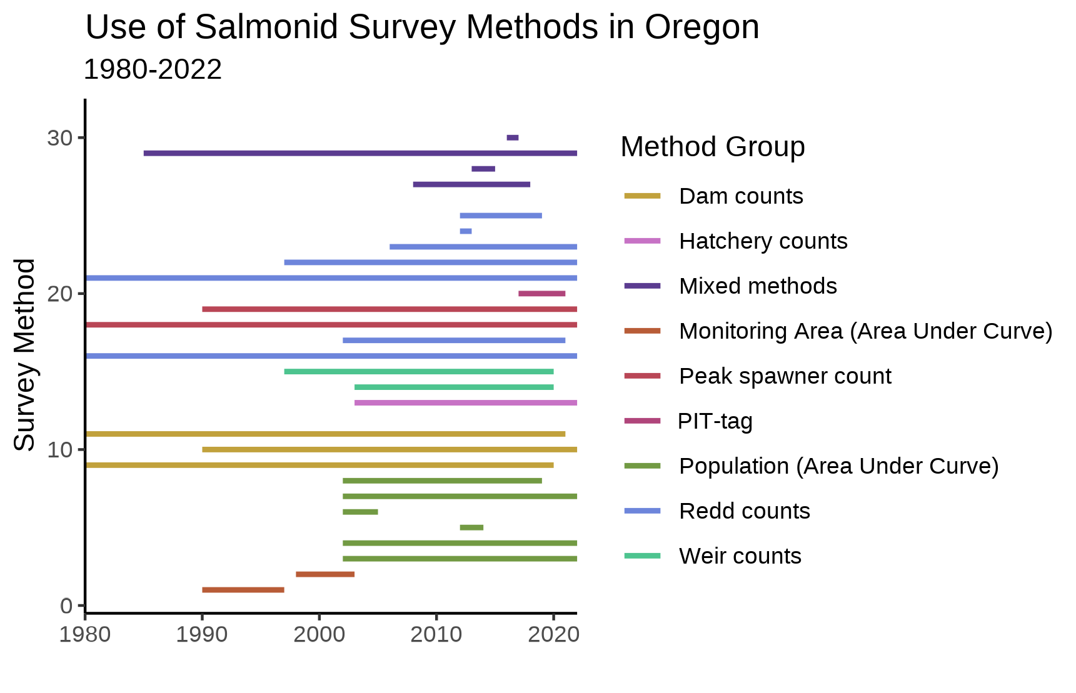
Data – survey methods

Slide 35
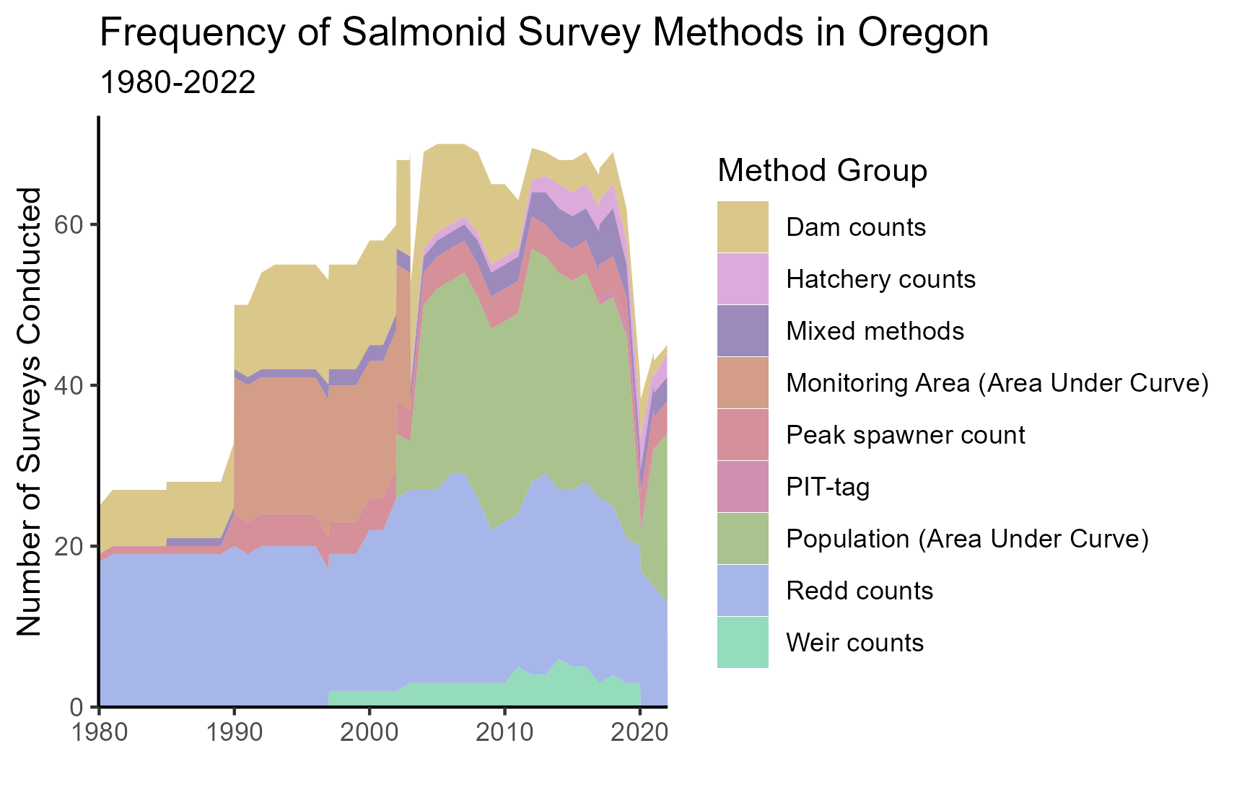
Data – survey methods

Slide 36
Analysis

Slide 37
Modeling approach
Multivariate Auto-Regressive State Space models
(MARSS)

Slide 38
Modeling approach
Multivariate Auto-Regressive State Space models
(MARSS)
Estimates underlying state based on observations

Slide 39
Modeling approach
Multivariate Auto-Regressive State Space models
(MARSS)
Estimates underlying state based on observations
Distinguishes observation error from noise in state being observed

Slide 40
Modeling approach
Multivariate Auto-Regressive State Space models
(MARSS)
x_{t} = Bx_{t−1} + u + w_{t}, where w_{t}∼MVN(0,Q)
y_{t} = Zx_{t} + a + v_{t}, where v_{t}∼MVN(0,R)

Slide 41
Modeling approach
MARSS models
Observation equation
x_{t} = Bx_{t−1} + u + w_{t}, where w_{t}∼MVN(0,Q)
y_{t} = Zx_{t} + a + v_{t}, where v_{t}∼MVN(0,R)

Slide 42
Modeling approach
MARSS models
Underlying state/process equation
x_{t} = Bx_{t−1} + u + w_{t}, where w_{t}∼MVN(0,Q)
y_{t} = Zx_{t} + a + v_{t}, where v_{t}∼MVN(0,R)

Slide 43
Modeling approach
What am I concerned with?
x_{t} = Bx_{t−1} + u + w_{t}, where w_{t}∼MVN(0,Q)
y_{t} = Zx_{t} + a + v_{t}, where v_{t}∼MVN(0,R)

Slide 44
Modeling approach
What am I concerned with?
x_{t} = Bx_{t−1} + u + w_{t}, where w_{t}∼MVN(0,Q)
y_{t} = Zx_{t} + a + v_{t}, where v_{t}∼MVN(0,R)
I am interested in observation bias (a) and observation variance (R)

Slide 45
Results

Slide 46
Results
Precision (R) and bias (a) terms estimated for 19 survey methods

Slide 47
Results
Precision (R) and bias (a) terms estimated for 19 survey methods
Not every method evaluated for every species

Slide 48
Results
Precision (R) and bias (a) terms estimated for 19 survey methods
Not every method evaluated for every species
12 methods with very few data points in the time series

Slide 49
Results
Precision (R) and bias (a) terms estimated for 19 survey methods
Not every method evaluated for every species
12 methods with very few data points in the time series
Bias can only be estimated relative to pre-specified reference method

Slide 50
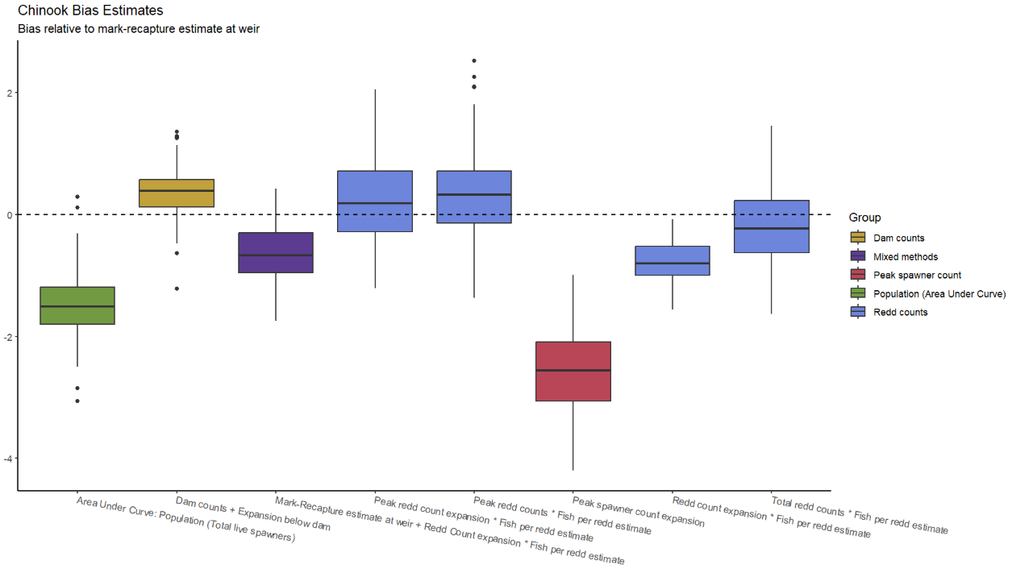
Results - Chinook

Slide 51
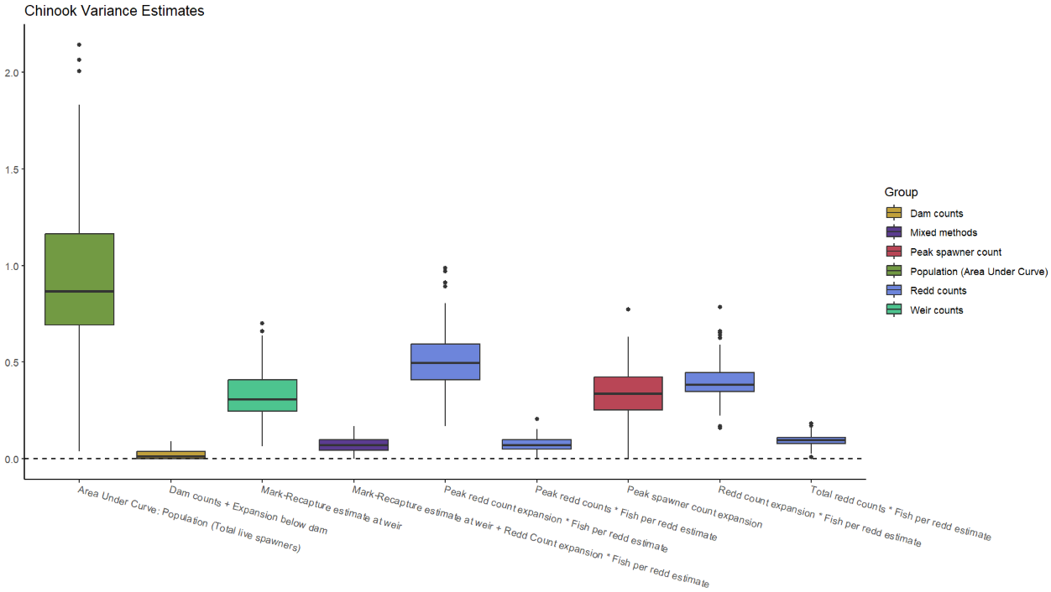
Results - Chinook

Slide 52
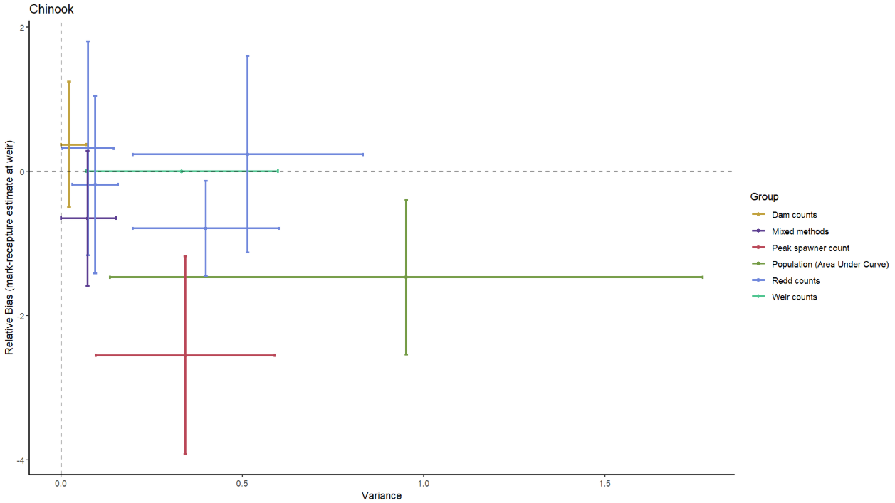
Results - Chinook

Slide 53
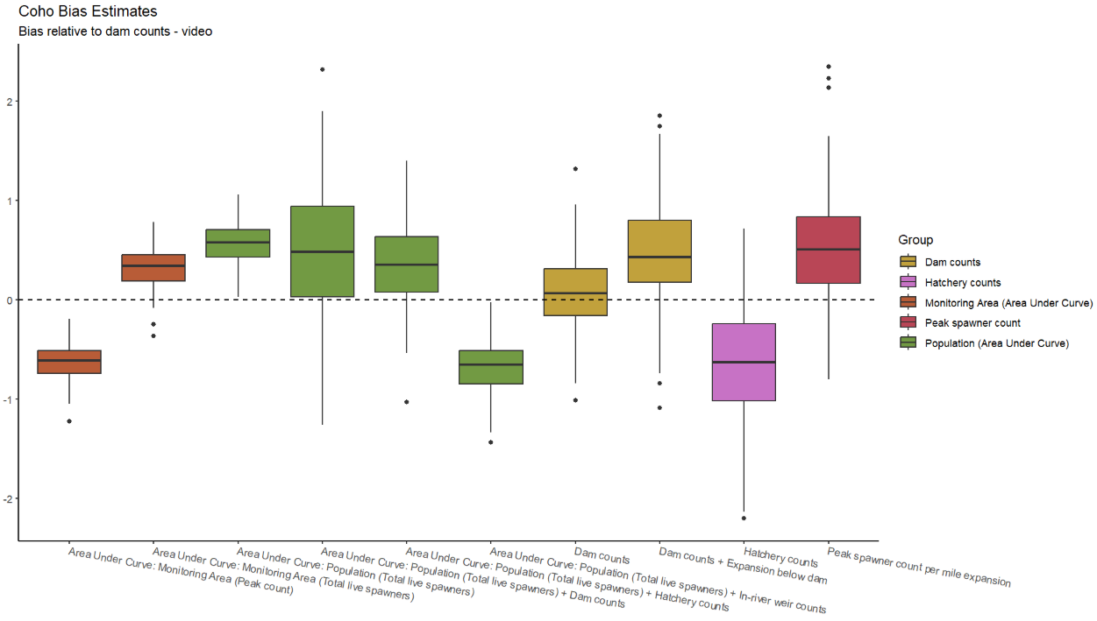
Results - coho

Slide 54
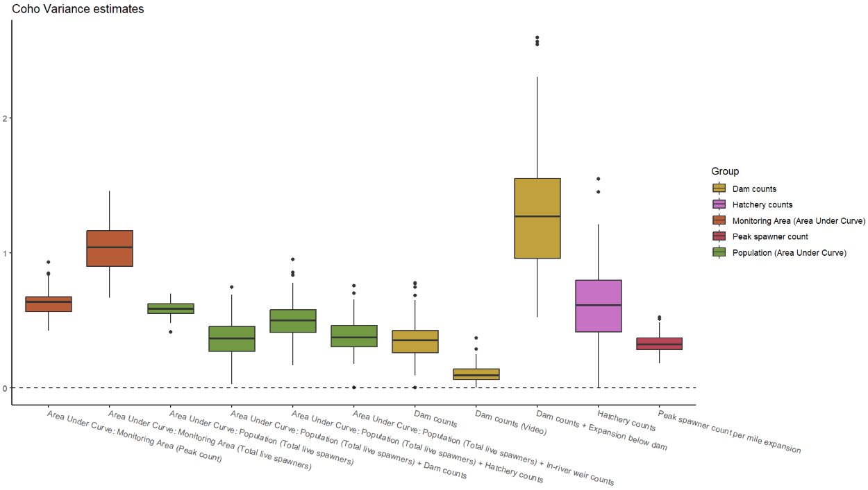
Results - coho

Slide 55
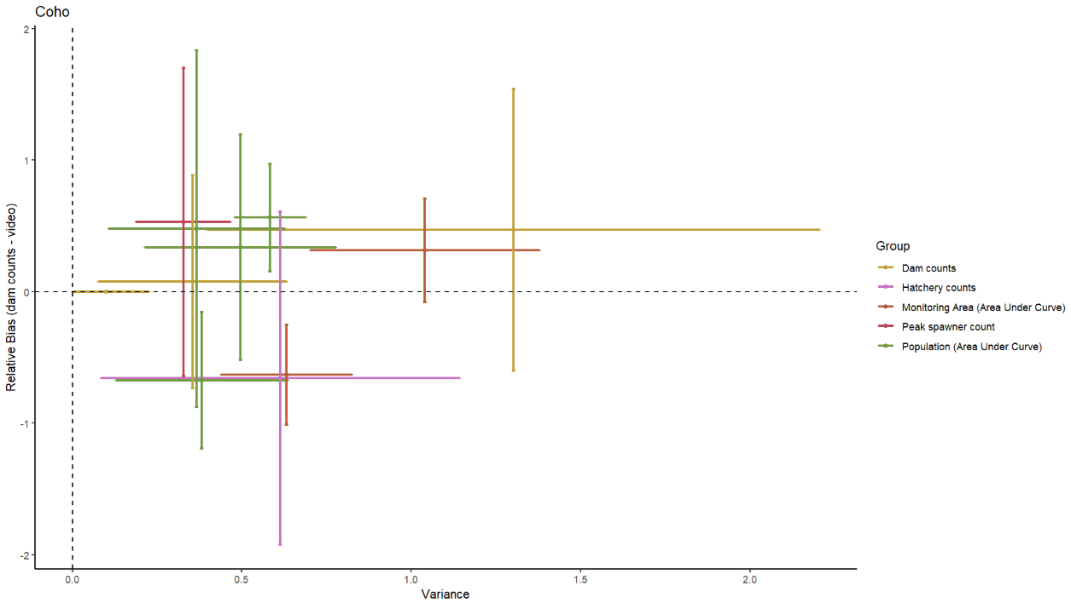
Results - coho

Slide 56
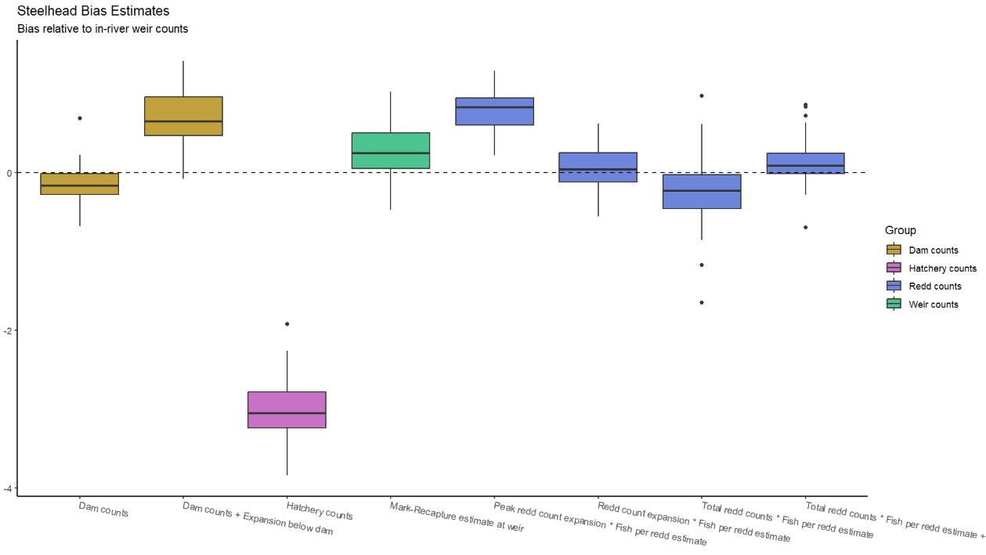
Results - steelhead

Slide 57
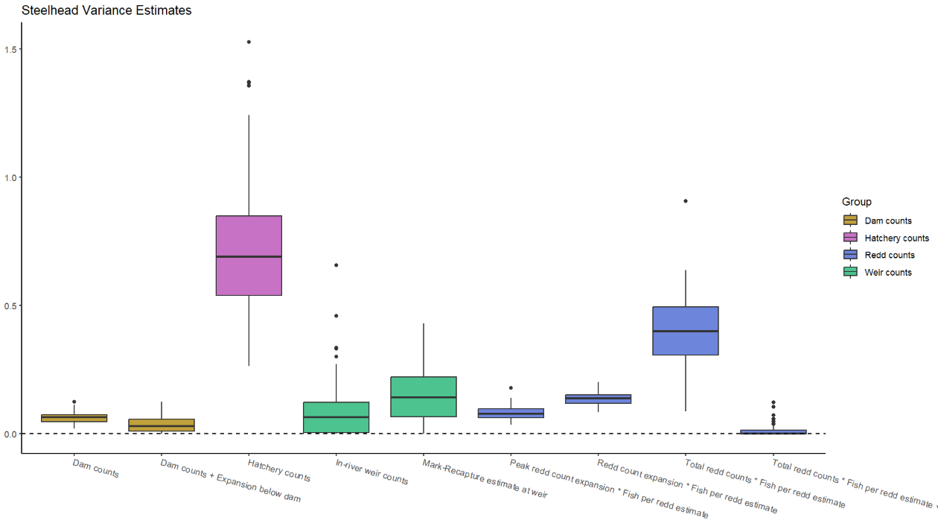
Results - steelhead

Slide 58
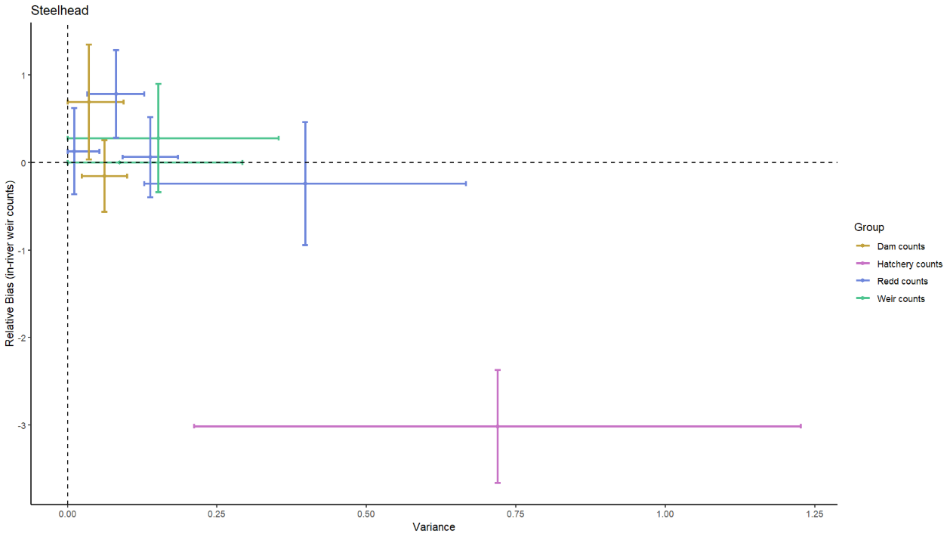
Results - steelhead

Slide 59
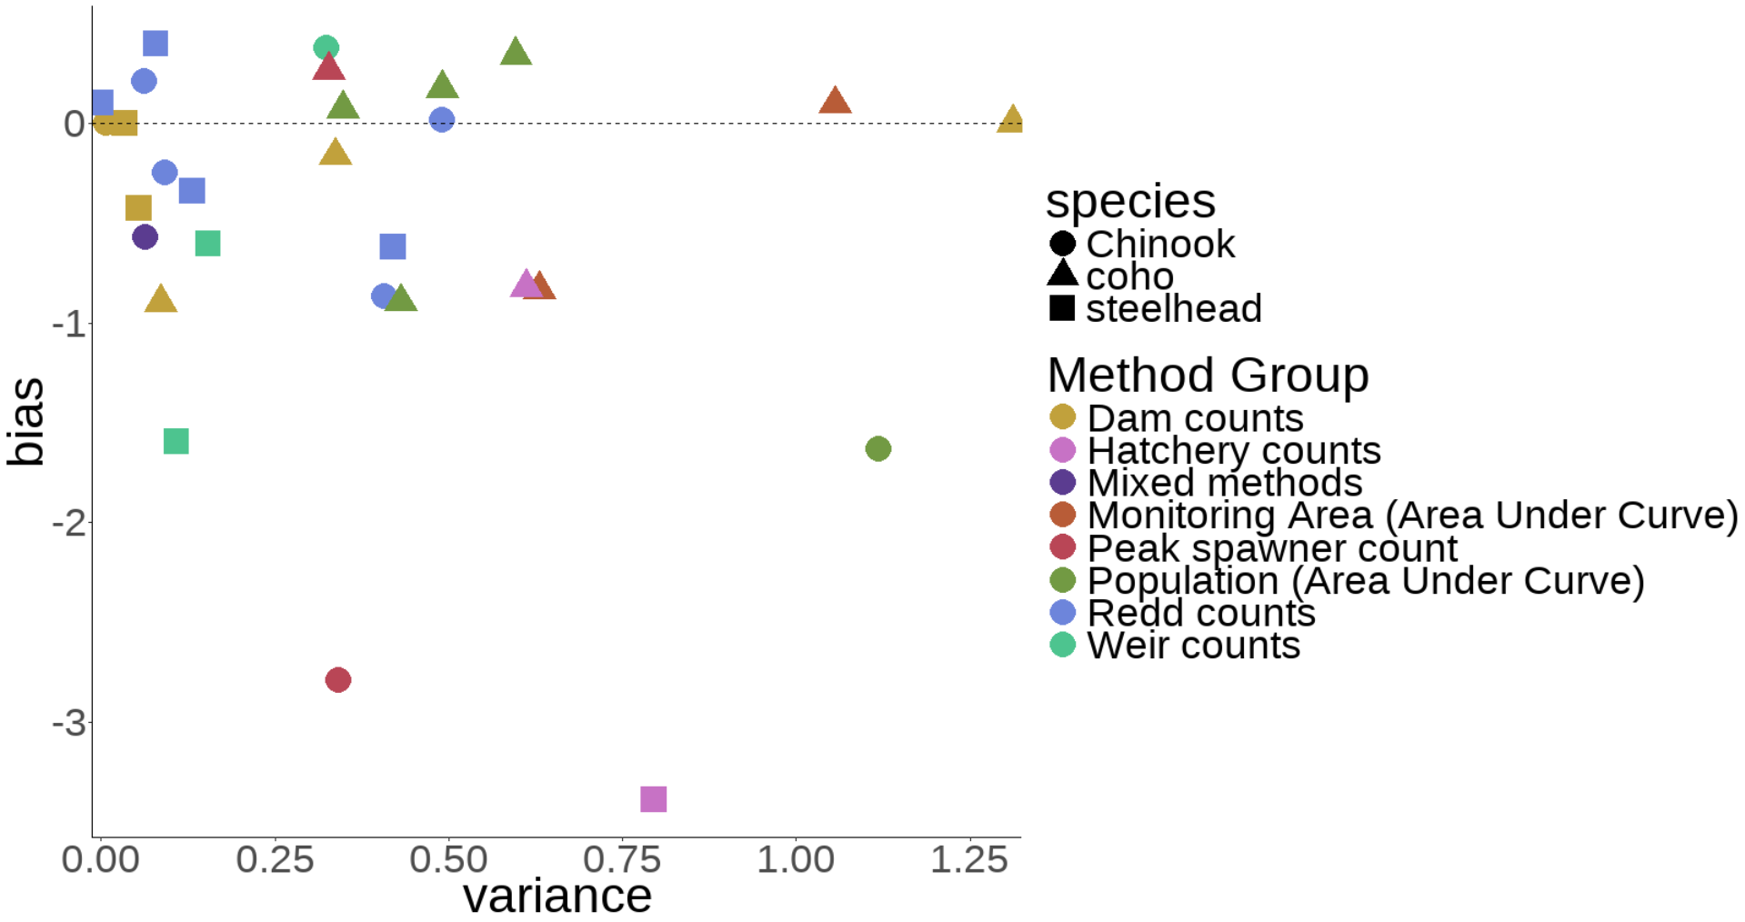
Results – all species
Reference method: Dam counts + Expansion below dam, a=0

Slide 60
Results
The same survey method can have very different levels of precision between species

Slide 61
Results
The same survey method can have very different levels of precision between species
Area-under-curve methods perform reasonably well for coho and poorly for Chinook

Slide 62
Results
The same survey method can have very different levels of precision between species
Area-under-curve methods perform reasonably well for coho and poorly for Chinook
Bias also seen to trend in different directions across species

Slide 63
Results
Coho generally more difficult to count precisely than Chinook or steelhead

Slide 64
Results
Coho generally more difficult to count precisely than Chinook or steelhead
Dam counts, weir counts, and redd counts tend to be most precise

Slide 65
Results
Coho generally more difficult to count precisely than Chinook or steelhead
Dam counts, weir counts, and redd counts tend to be most precise
Hatchery counts are terrible

Slide 66
Discussion & Next Steps

Slide 67
Discussion
Wide variety of survey methods available to biologists

Slide 68
Discussion
Wide variety of survey methods available to biologists
Understanding bias and precision is crucial

Slide 69
Discussion
Wide variety of survey methods available to biologists
Understanding bias and precision is crucial
Decisions such as ESA listing are dependent on accurate estimates

Slide 70
Next Steps
Evaluate cost of survey methods
Value of information

Slide 71
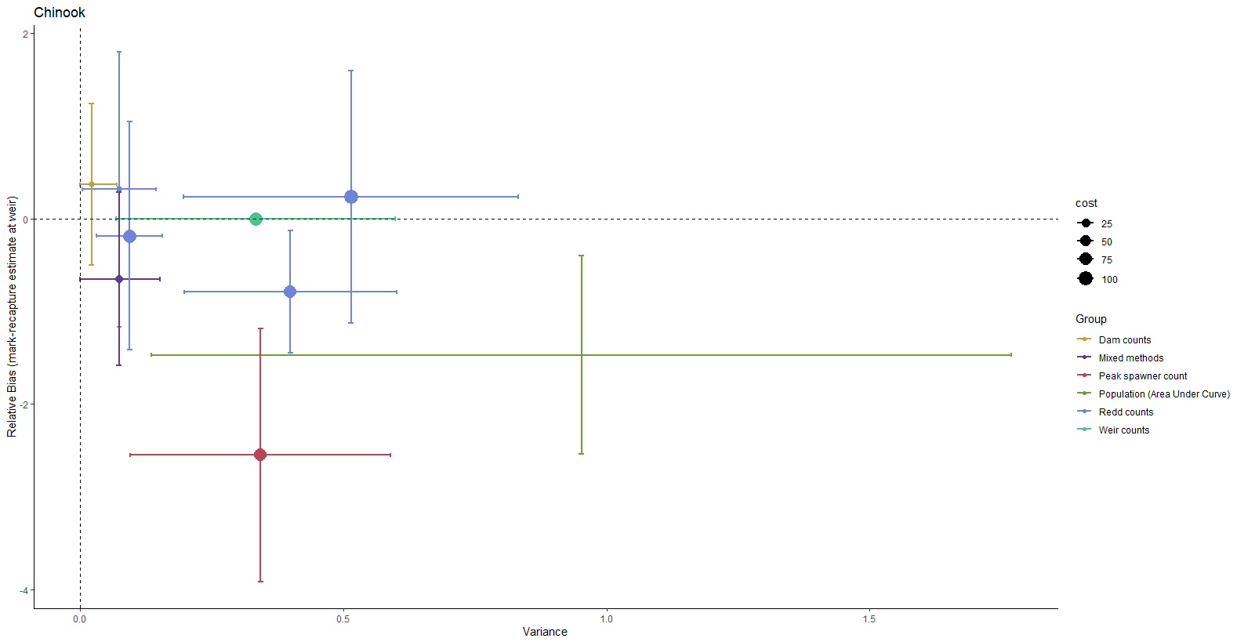
Next Steps
Evaluate cost of survey methods
Value of information

Slide 72
Next Steps
Evaluate cost of survey methods
Value of information
Additional data to compare estimates?
Could similar data be available from Washington

Slide 73
Next Steps
Evaluate cost of survey methods
Value of information
Additional data to compare estimates?
Could similar data be available from Washington?
Effect of location
Could stream geomorphology impact survey accuracy?

Slide 74
Evaluating Salmonid Survey Methods for Precision and Bias Brian McGreal – FISH 550

Slide 75
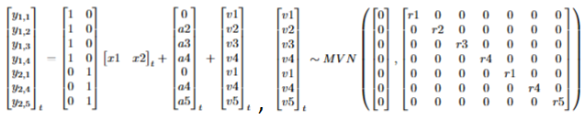
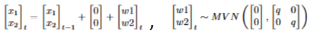
Modeling approach
Specifying matrices properly is crucial

Slide 76
Modeling approach
Specifying matrices properly is crucial
A reference method must be chosen to estimate bias

